Slide 1

Promoting the welfare of refugees, one family at a time

Slide 2
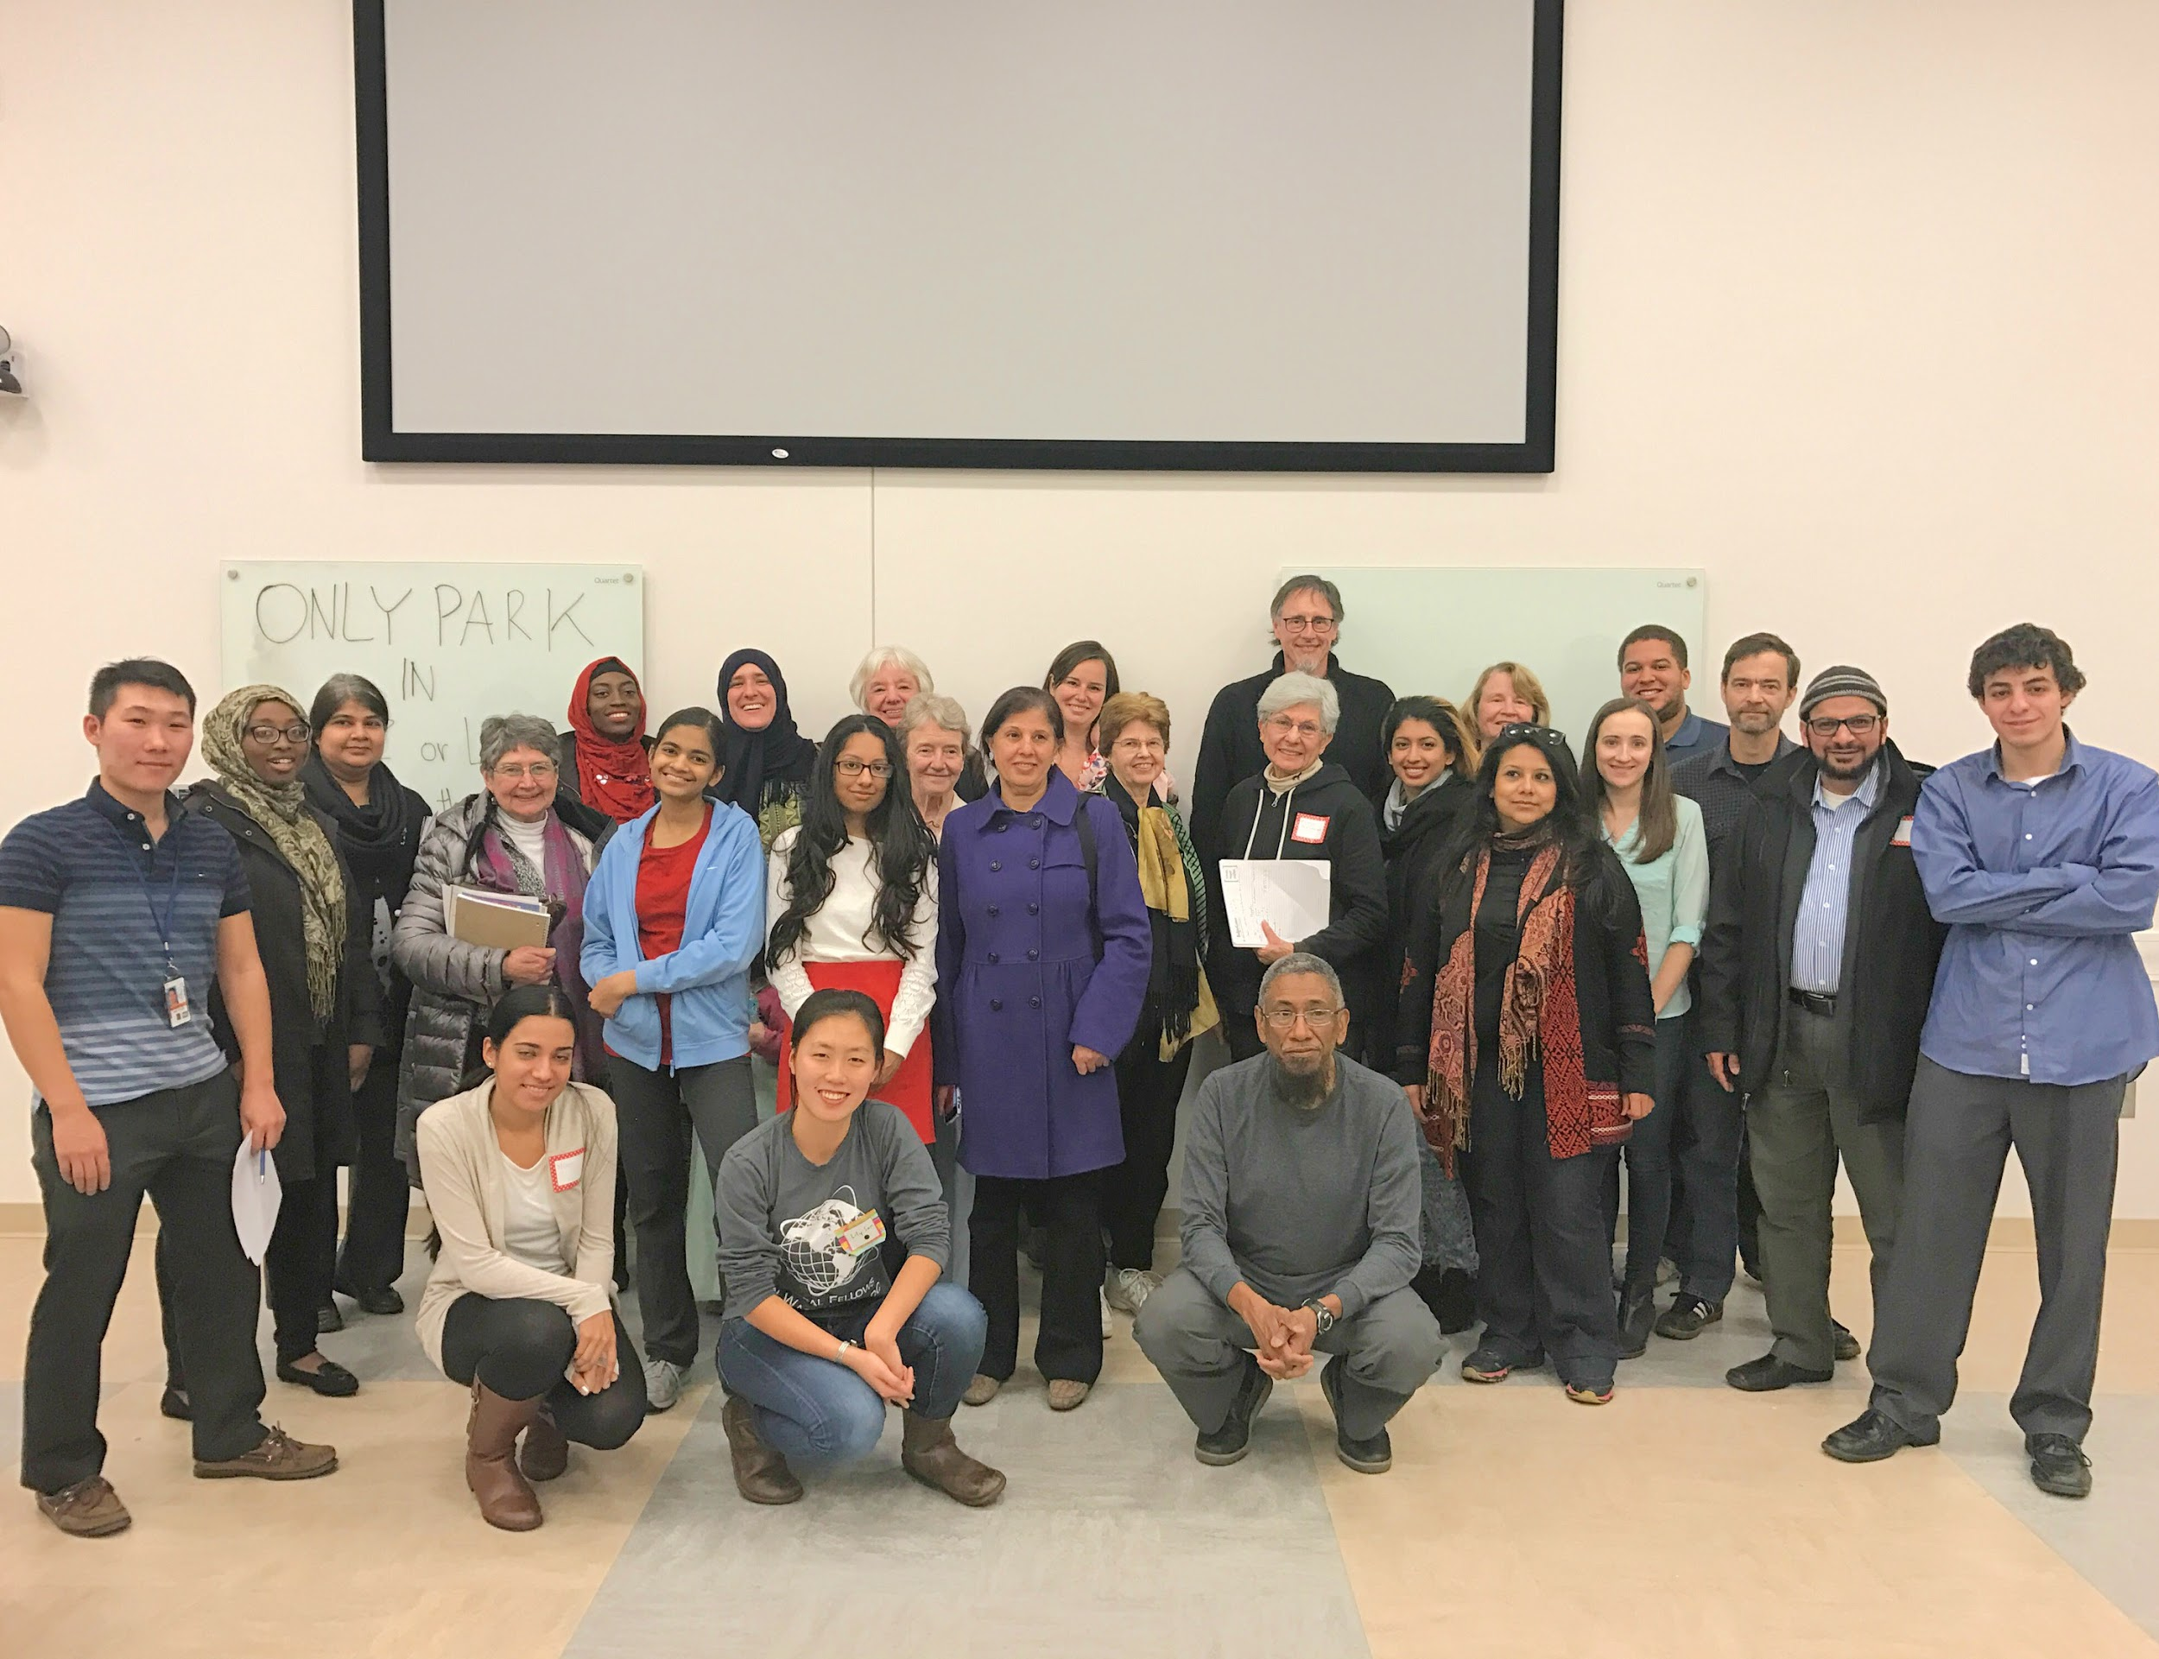
About Us
New Horizons is a 501(c)(3) nonprofit organization founded in 2016 to provide educational services to help immigrants and refugees settle and integrate into the United States.
Our primary initiative to provide English mentoring for individuals of all ages and skill levels.
Our future initiative to provide mentoring and tutoring in multiple subjects.

Slide 3
Future Opportunities - On the Horizon
UMD campus club “New Horizons” sponsored by Professor Julie Greene
Events at the University of Maryland, Baltimore County for refugee families in Baltimore area
Private In-Home Tutors
Tutors for multiple subjects

Slide 4
Refugee Students
20+ families in Riverdale, MD area
Primary languages include Arabic, Dari, Urdu, and Pashto
All languages use Arabic script
Fluency in these languages not necessary to mentor

Slide 5
English Mentorship Weekly Sessions
Mentor either in Shift 1 (1-3pm) or 2 (2-4pm)
Each shift consists of:
  45 minute session
  30 minute break
  45 minute session
Volunteers are paired with the same family or individual(s)

Slide 6
Mentor Responsibilities
Confirm attendance of your student(s) to each event
Plan the day’s lesson
Assign homework, if necessary
Fill out progress report at the end of each event
Keep in touch and look out for the wellbeing of your student
Notify supervisors of any issues or ways we can help

Slide 7
Engaging with Refugees
Know each student’s name and make sure they know yours
Speak slowly
Repeat yourself
Provide positive reinforcement at every opportunity
Focus on comprehension and correct grammar later (for Level 1 students)
Ask before taking pictures
Your mentoring doesn’t end in the classroom; be their friends

Slide 8
Level 1 Curriculum: Pedagogy
Lay the Foundation: ABCs and 123s, letter groups (ch, th, wh, ing, ong, ow, ee, oo, tr)
Build a word bank: Colors→ Common nouns→ Emotions→ Verbs→ Adjectives→ Pronouns→ Prepositions
Form basic sentences with the word bank using the pronoun “I” (“I walk to the park,” “I wear a hat”)
Conjugate verbs using other pronouns (“They walk to the park,” “He wears the hat”)
Conjugating the verb “to be” (“I am happy,” “He is happy,” “We are happy”)
Tell Time
Who, What, When, Where Why? Understanding questions

Slide 9
Level 2 Curriculum: The Conversation Begins
Continued vocabulary acquisition (flash cards)
Past and Future tense verb conjugations
Learning common and colloquial phrases
Object description exercises
Role playing real world scenarios
Reading comprehension development (read a picture book together and discuss)

Slide 10
Level 3 Curriculum: Leaving the Nest
Conversations about US culture and customs
Practicing English in the field
Cultural immersion experiences and trips
Practice reading newspaper articles

Slide 11
Attendance
Dependant on individual you mentor
Minimum 3/4 events a month
Notify at least 3 days in advance of absence
Private Tutoring

Slide 12
Drivers
Critical to operation of each event
Homes within a 15 minute radius to campus
Drive either for Shift 1 (1pm) or 2 (2pm)

Slide 13
Arabic Translators
Help with outreach and communication with families

Slide 14
Opportunities
English Tutor
Site Supervisor
Event Planner
Transportation Coordinator
Social Media Coordinator
Child Care Supervisor
Campus club directors

Slide 15
Questions or Comments?
Email us at horzionshine01@gmail.com

